Slide 1
Bhoomi Panchal
Assignment 3: Mini Learning Story and Documentation

Slide 2
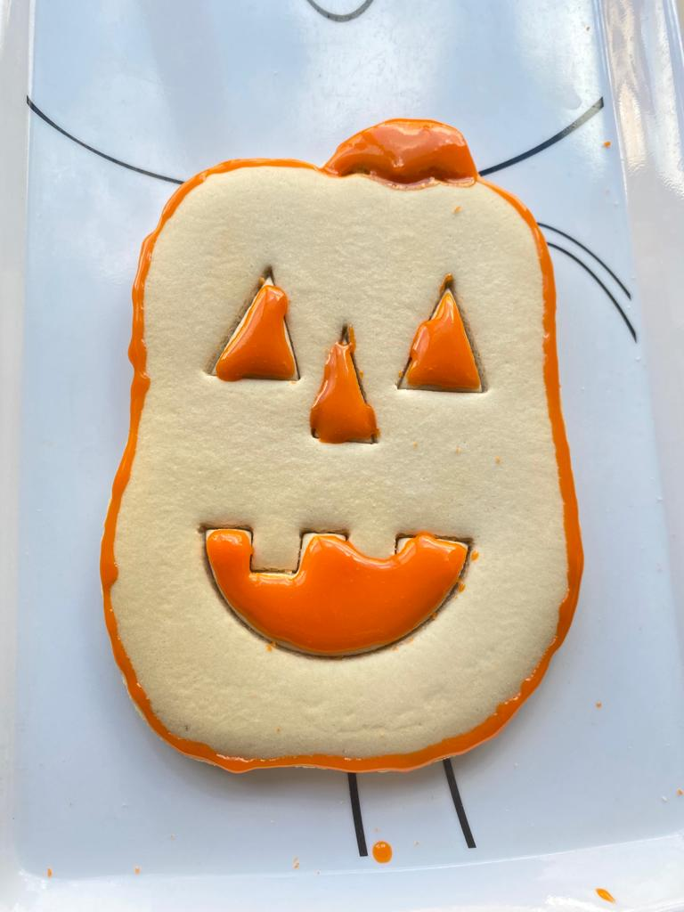
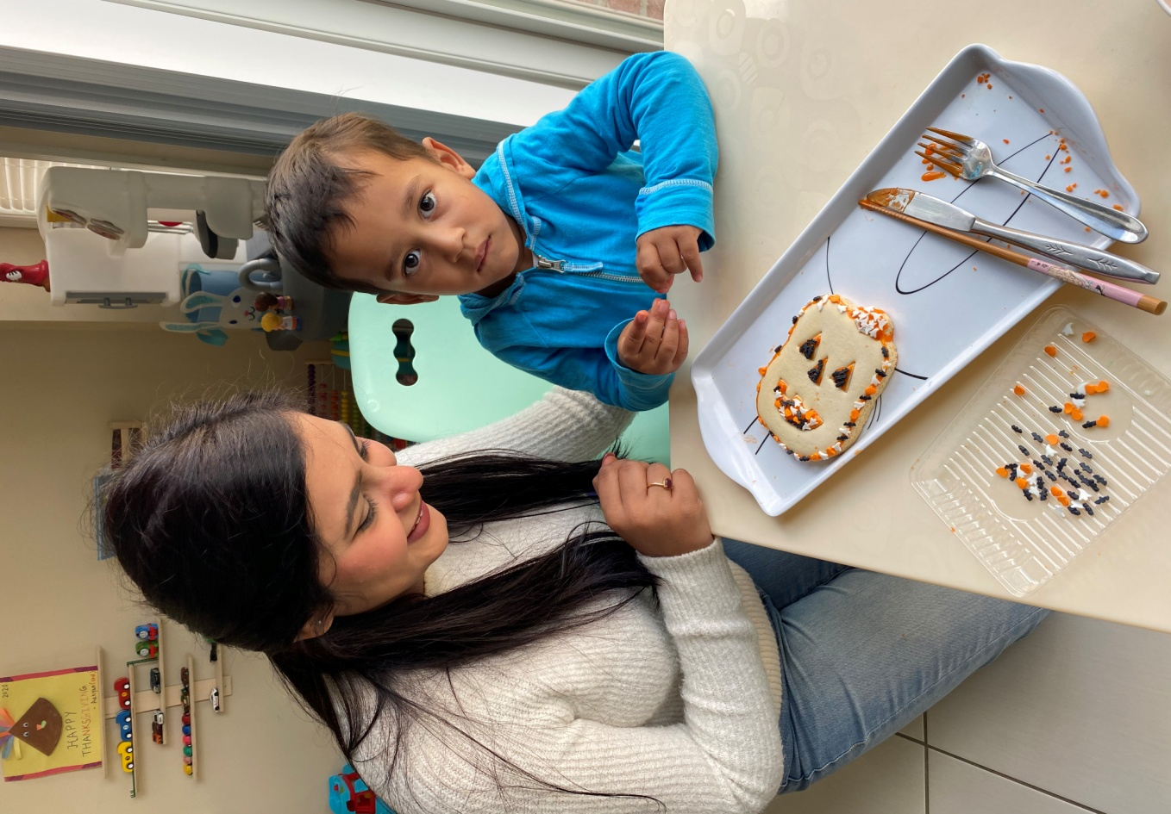
Here we are doing an cooking activity. We are making pumpkin cookies. All we arrange all material first. We have premade cookie dough and we have orange frosting and orange, black and white sprinkles.

Slide 3
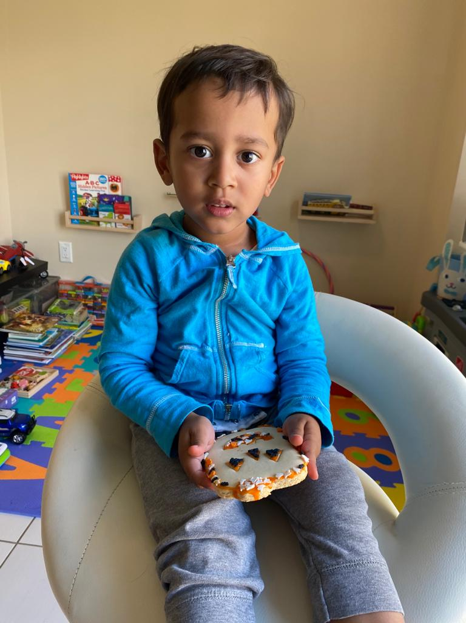
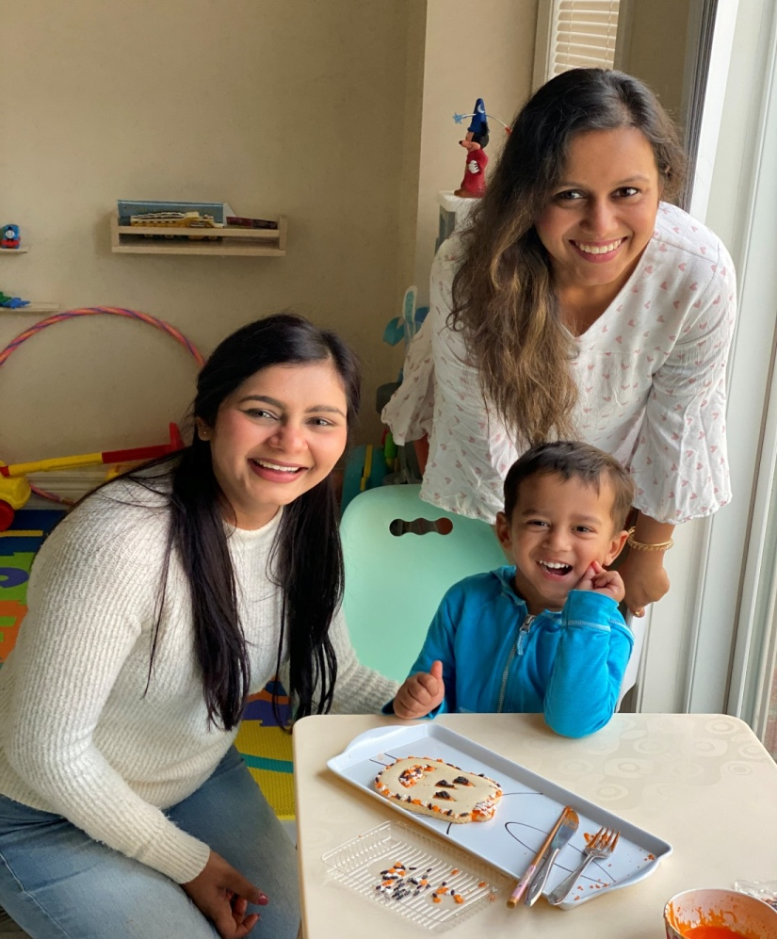

Slide 4
I put all cooking material with stuff on table for him and I explain him how we are going to make pumpkin cookie and decorate with sprinkles. He was so excited to make it. He asked me how can we put frosting on cookie and later on can we eat it? He said I love to make cookie, he told me he helped his mom at home while cooking. He put all frosting on cookie and then decorate with black and orange sprinkles.
If I talk about connection how does learning happen here so it will be like this.
Belonging- He did his best, he involved in every step of process. He also shows me that he is helpful to me and others at his home.
Well-being- Through this activity I can see he gave me his own idea and he was so creative.
Engagement- He was a active child, he put all sprinkles very perfect on the line. He uses his own sense and creativity.
Expression- I can not believe how happy he was after making this cookie, and he asked me to share with him. When his mom asked that who made this cookie? So He said that me and my miss both made nit together. He gave credit to me as well.

Slide 5
